Slide 1
Project Evaluation Phase 1
NOTHING by NULL
Soumya Singh
Samaksh Tyagi
Shobhit Choudhury

Slide 2

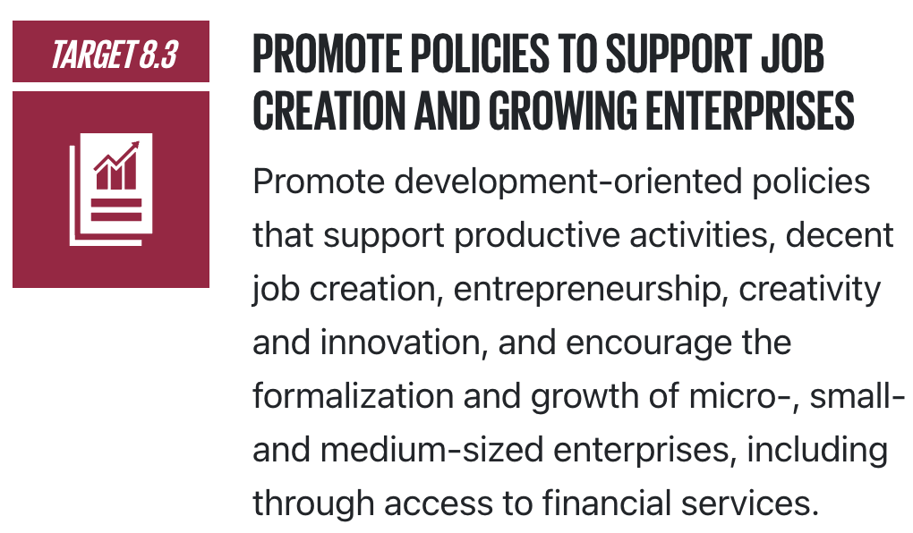
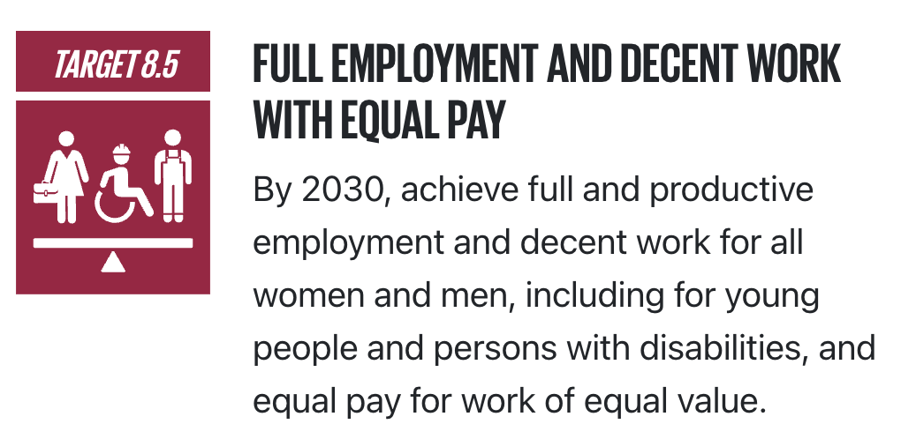


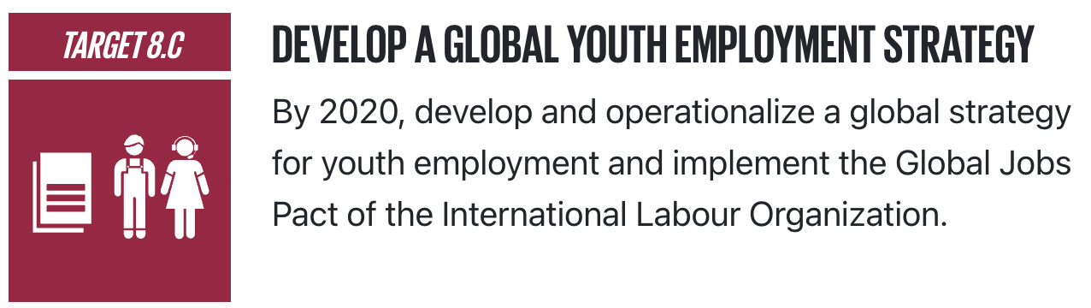



Idea/Approach Details:
Corporate Management System
Handling records, working and editing them could be a hectic job. We will be creating a business management system using python, which allows corporate giants to work on their datasets without any hassles. Whether it's applying for a job based off your skills and the company's requirement, or fair promotion based on work hours or insights on company employees, our management system will have it all! We'll incorporate user friendly record handling with colourful graphs to make analysis on employees simple and efficient.
Our main goal is in line with the 17th SDG goal "Decent Work and Economic Growth" with sub targets like:
8.3: "Promote policies to support job creation and growing enterprises",
8.5: "Full employment and decent work with equal pay",
8.C: “Develop a Global Youth Employment Strategy”
Technology stack / Dependencies:

Slide 3
Application Area
USE CASES:
SHOW STOPPER:
Business Sector : A plethora of corporations deal with all assessment information through the data set administration framework (DBMS).
Data retrieval: DBMS provides a way to retrieve data quickly and easily using search queries.
Data manipulation: DBMS provides tools to manipulate data, such as sorting, filtering, and aggregating data.
Security: DBMS provides security features to ensure that only authorized users have access to the data.
Data backup and recovery: DBMS provides tools to backup data and recover it in case of system failures or data loss.
Multi-user access: DBMS allows multiple users to access and modify data simultaneously.
Reporting and analysis: DBMS provides tools to generate reports and analyze data to gain insights and make informed decisions.
Highly precise, accurate and quick data analyses.
Smooth and powerful data visualisation environment will be incorporated to analyse your complex datasets with ease.
The DBMS is secure since it’s exclusive to company superiors and requires unique id and password.
Exportation of the analysis is also possible in various formats.
Interactive GUI ✨
Focuses on various sustainable development goals as well to focus on the bigger picture.
Saving crucial time of the companies by automatically labelling attributes while analysing.
Valuable insights and trends on employees are clearly seen in the visually represented graphs.
Data Scientists can view and analyse their company’s data efficiently
Channels: Recruiters and Data Analysts in Govt., Industries, Organizations, Corporations, etc.,

Slide 4
Team Details and Work Distribution
Team Member Details:
Work Distribution Details:
Team Member 1: Soumya Singh
Course: Btech CSE
Enrollment No.: E23CSEU1297
Team Member 2: Samaksh Tyagi
Course: Btech CSE
Enrollment No.: E23CSEU1303
Team Member 3: Shobhit Choudhury
Course: Btech CSE
Enrollment No.: E23CSEU1304
Team Member 1: Soumya Singh
Team Management
Brainstorming Ideas
Presentation (Introduction)
Team Member 2: Samaksh Tyagi
Content for PPT
Working with Databases
Presentation (Ideation)
Team Member 3: Shobhit Choudhury
Research
GUI
Presentation (Applications)
40 hours of therapy+10 hours of coding = 50 hours

Slide 5

Thank You

